Slide 1

Website Blackboard

Slide 2

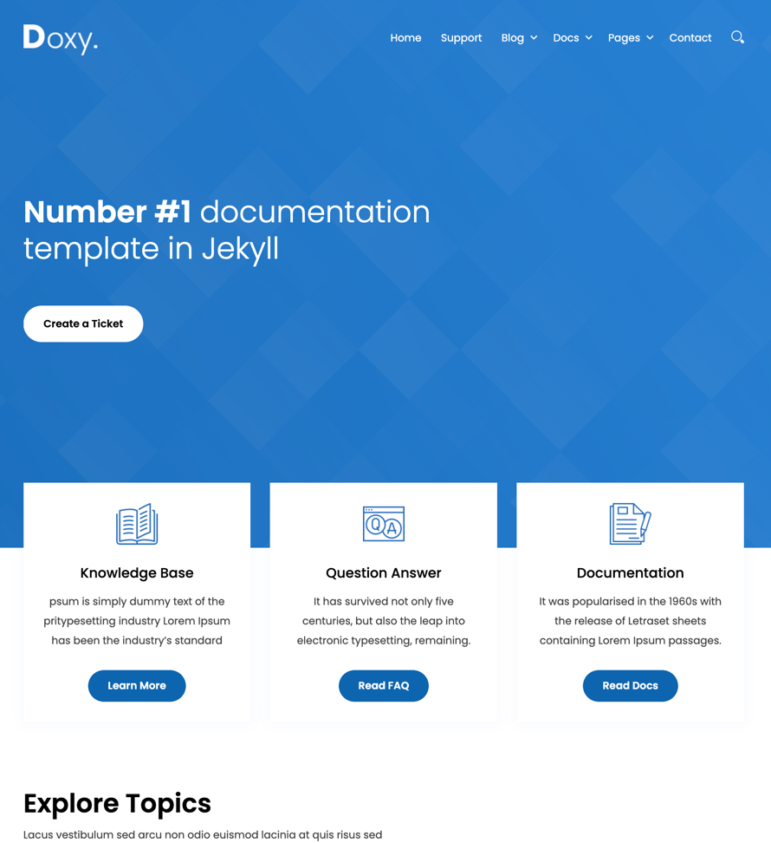

Home Page
Logo for the page
Favicon for the page (see: http://realfavicongenerator.net/)
Donation Paypal Button
Slider
Download
Documentation
Donate
3 Main Areas
What can I do with BlackBoard?
Start using BlackBoard!
BlackBoard Samples!
Explore Topics
Documentation
Chapters sind Tags, Categorien
Contact Us
E-Mail Form
Footer

Slide 3
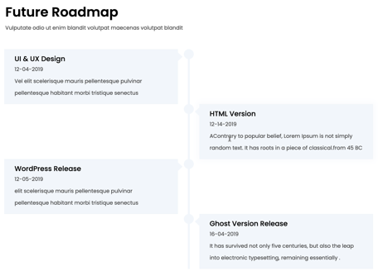

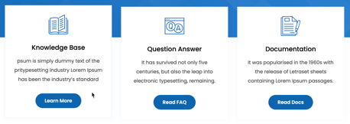


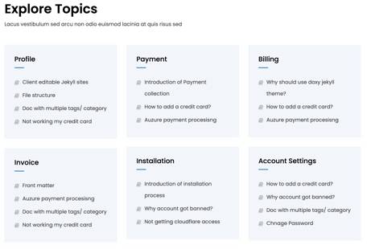
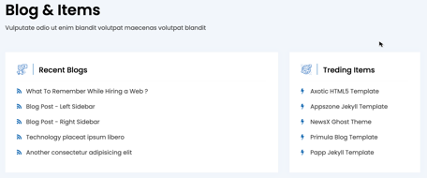
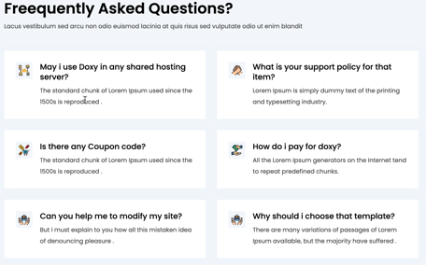

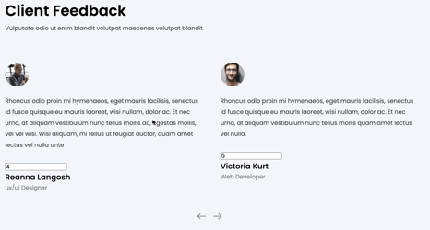


Main Page Elements
Slider with Button
3 Main Areas with Button
Team Slider

Slide 4
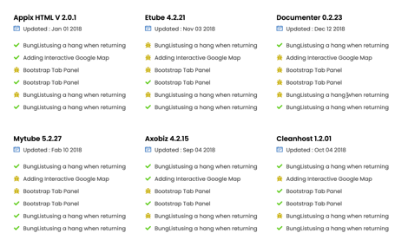
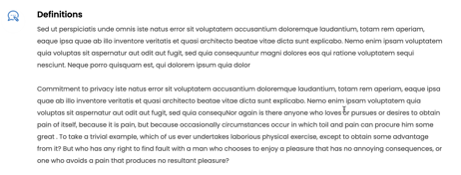
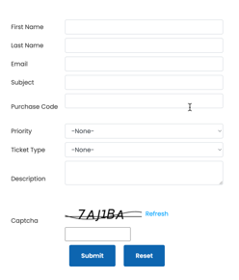
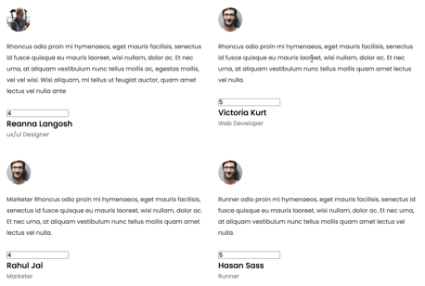
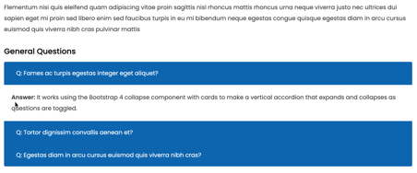
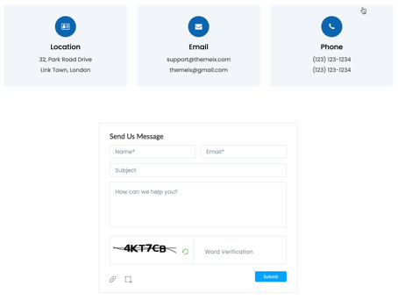
Other Page Elements
Privacy Policy Page
Changelog Overview Page/Section
Form Page
FAQ Page/Section
Testimonials Page/Section
Contact Form Page

Slide 5

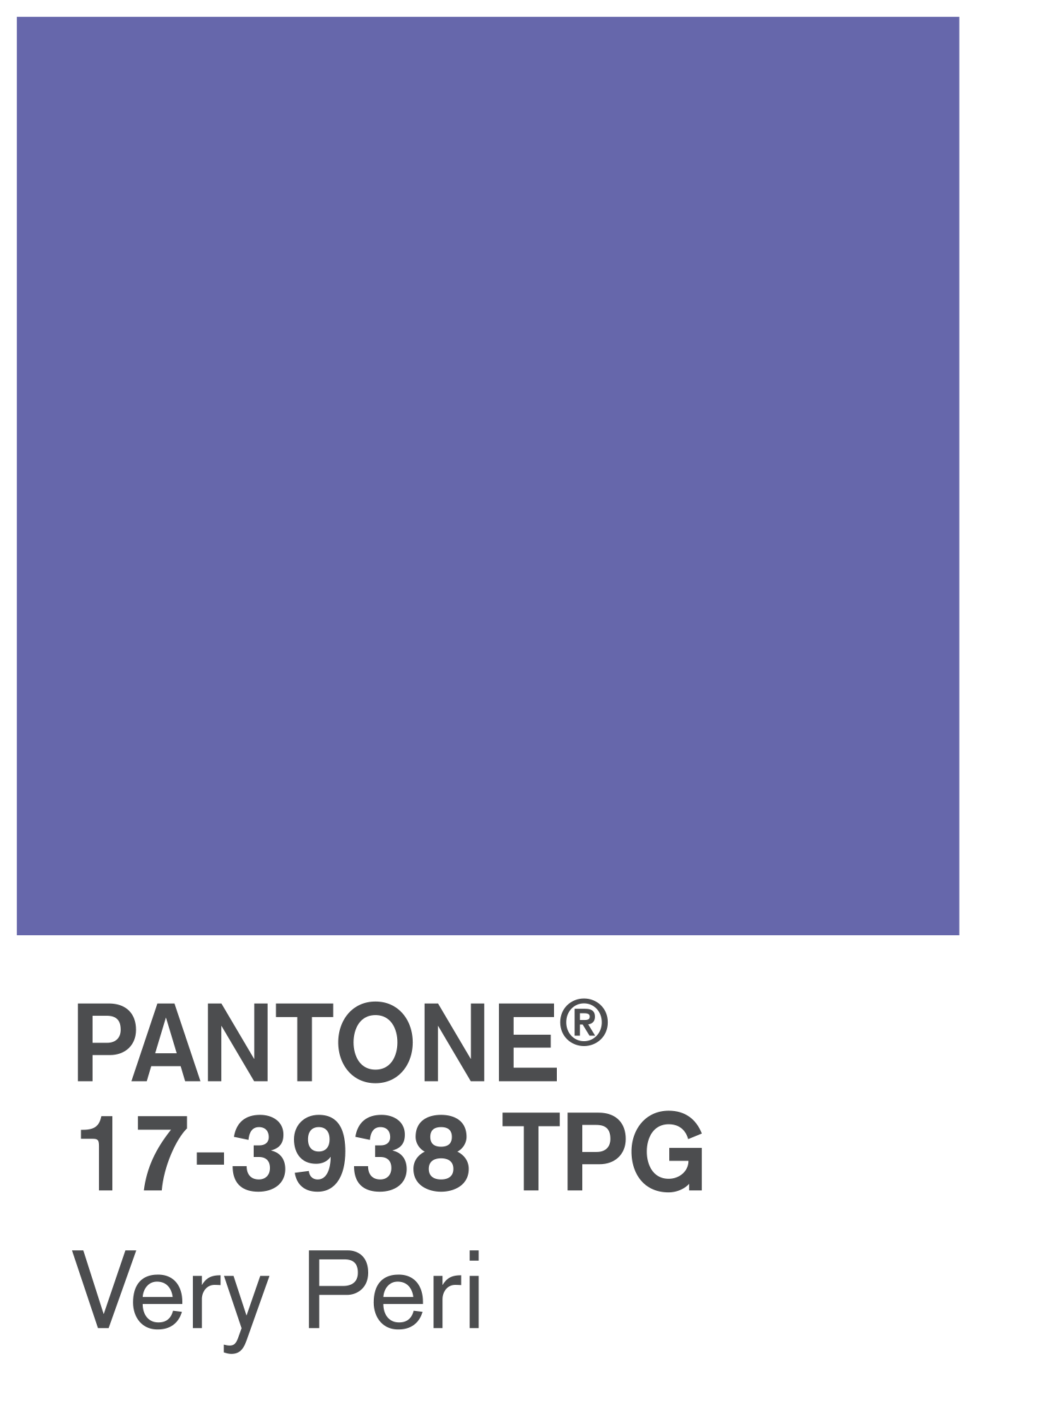
VERY PERI
Introducing the Pantone Colour of the Year 2022. PANTONE 17-3938 Very Peri is a dynamic hue that blends the faithfulness and constancy of blue with the energy and excitement of red.
The four colour palettes in this template feature Very Peri to help you express your ideas and convey the right mood. Read on to learn how to use these colours in any presentation.

Slide 6
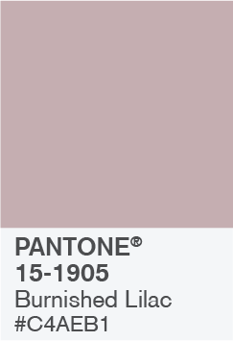
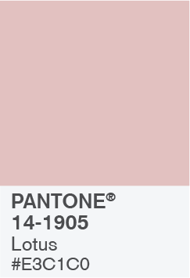
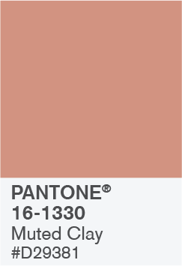

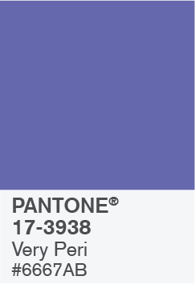

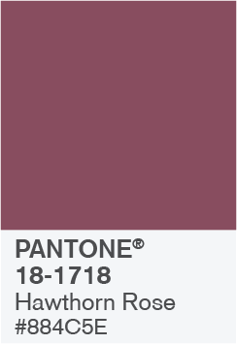
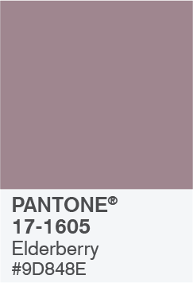
BALANCING ACT

Slide 7

BALANCING ACT
Use this colour palette when you want a balance between warm and cool. PANTONE Very Peri is intensified within this artfully calibrated palette, injecting a feeling of liveliness and visual vibration.

Slide 8



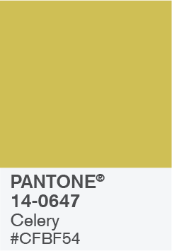



WELLSPRING

Slide 9

WELLSPRING
Use this colour palette when you want a blend of nature-infused hues that highlight the compatibility of the greens and the “health giving” properties of these deliciously subtle and nourishing hues.

Slide 10


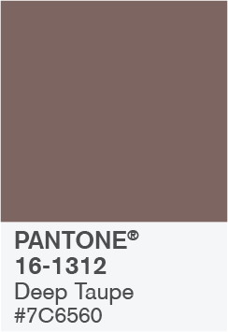



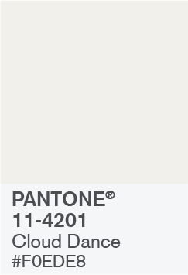
THE STAR OF THE SHOW

Slide 11
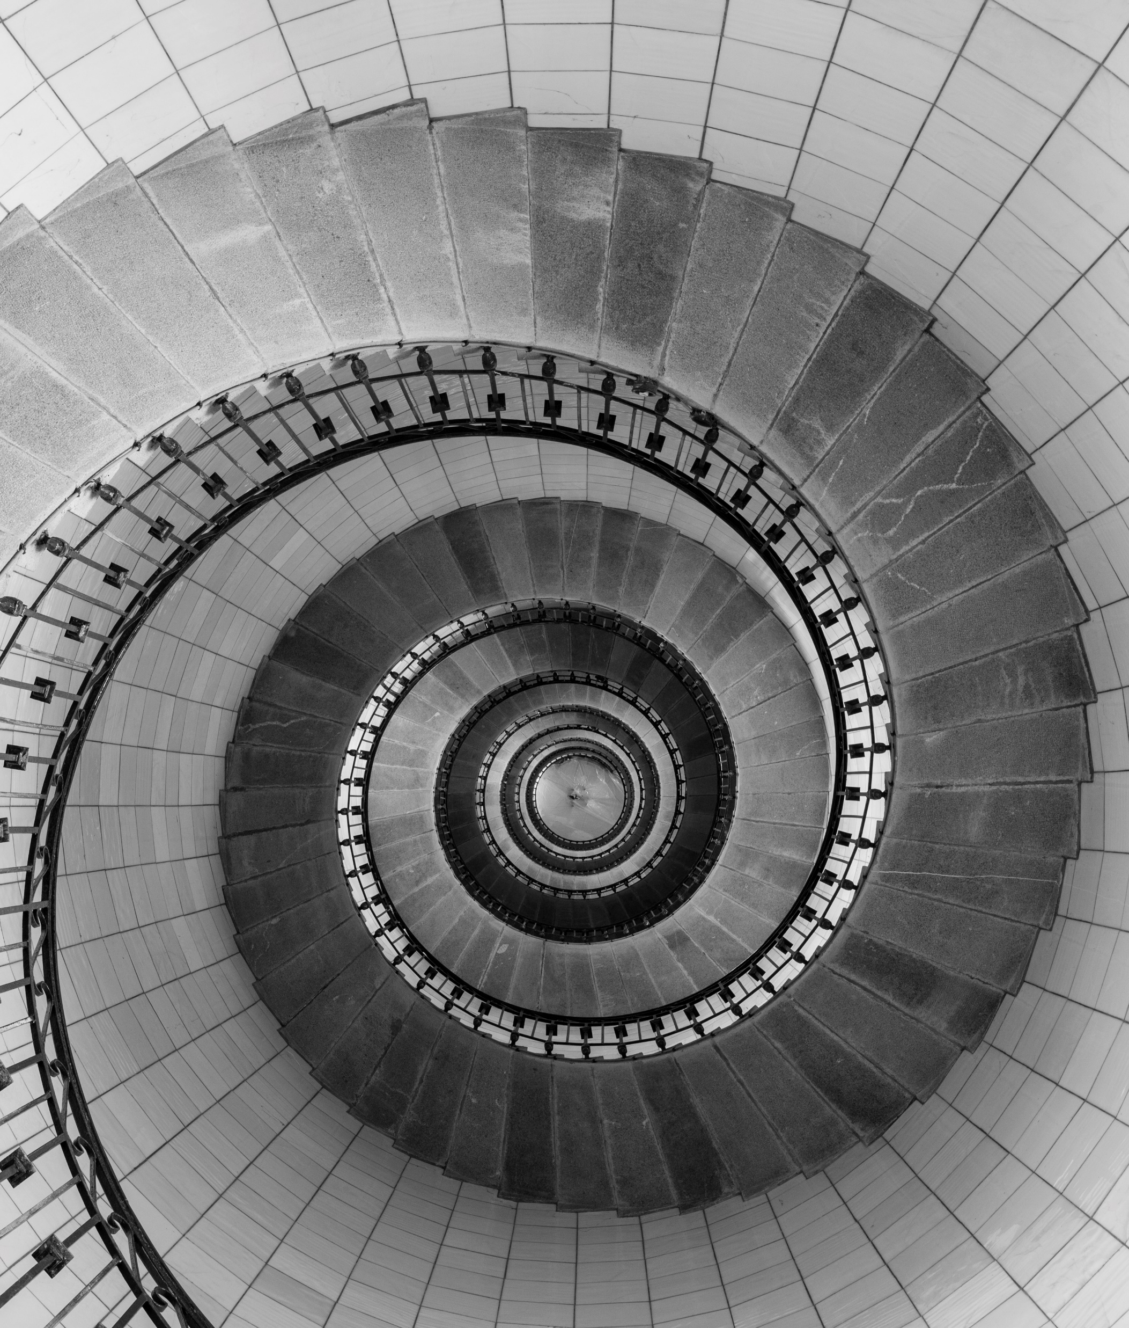
THE STAR OF THE SHOW
When you want a more elegant approach, the dynamic presence of PANTONE Very Peri shines as the star of the show in this palette of classics and neutrals whose understated stylishness conveys a message of timeless sophistication.

Slide 12
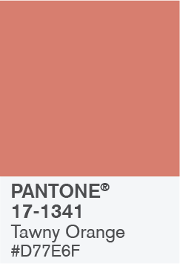
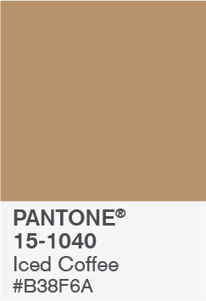
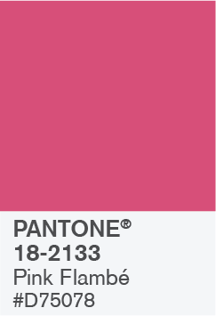
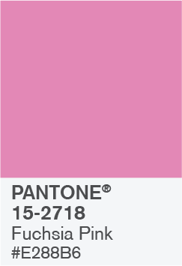
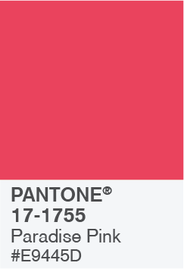
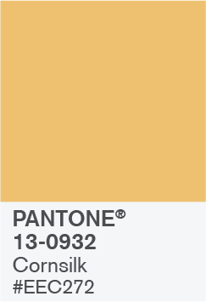

AMUSEMENTS

Slide 13

AMUSEMENTS
Use this colour palette when you want to tell a joyous and whimsical story. In this palette, PANTONE Very Peri injects a sense of playful freshness into the design, exuding a good-natured warmth that quickly engages the eye.

Slide 14
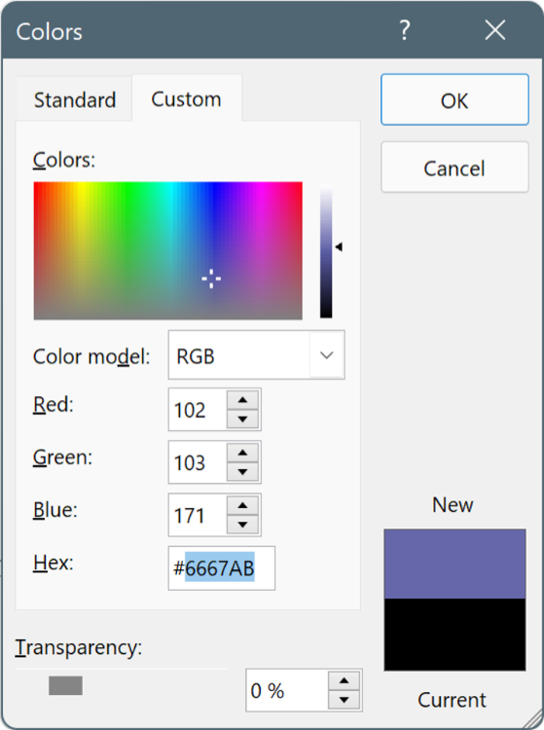
USE THESE COLOURS IN ANY POWERPOINT PRESENTATION
Select a shape or text box border. When you do that, the Shape Format tab appears.
On the Shape Format tab, select Shape Fill > More Fill Colours.
In the Colours box, select the Customised tab.
Enter the Hex value of the colour you want to use.
Tip: To change multiple shapes or text boxes, click the first shape or text box, and then press and hold Ctrl while you click the other shapes or text boxes.

